Slide 1

U.S. Space Policy
Fall 2026
Apollo and its Impacts
(with thanks to John Logsdon)
Dr. Scott Pace
George Washington University
Elliott School of International Affairs
space1@gwu.edu
1957 E Street, NW
Suite 403

Slide 2
ORIGINS
NASA chose a lunar landing as its long-range goal in 1959
NASA announced Apollo as its post-Mercury program in mid-1960
  At that point, the goal was to build a three person spacecraft for both longer duration Earth orbit flights and circumlunar flights
NASA began preliminary planning for a lunar landing in October 1960
President Eisenhower was briefed on this planning in December 1960 and reacted quite negatively

Slide 3
INITIAL KENNEDY VIEWS ON SPACE
Transition task force cautioned JFK about emphasis on human space flight
Kennedy saw space as an area of common interest with the Soviet Union and thus a potential area of cooperation
  Space cooperation mentioned in both Inaugural Address and State of the Union
Kennedy deferred decisions on future space programs (except for more powerful rocket engines) in March 1961

Slide 4
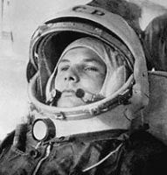
YURI GAGARIN – FIRST HUMAN IN SPACE – APRIL 12, 1961
Once again, the Soviet Union gained much positive reaction around the world by being first to send a human into orbit
John F. Kennedy, decided that the United States had to enter – and win – a space race
Decision was also influenced by Bay of Pigs fiasco, April 17-20 – but how much influence is not clear

Slide 5
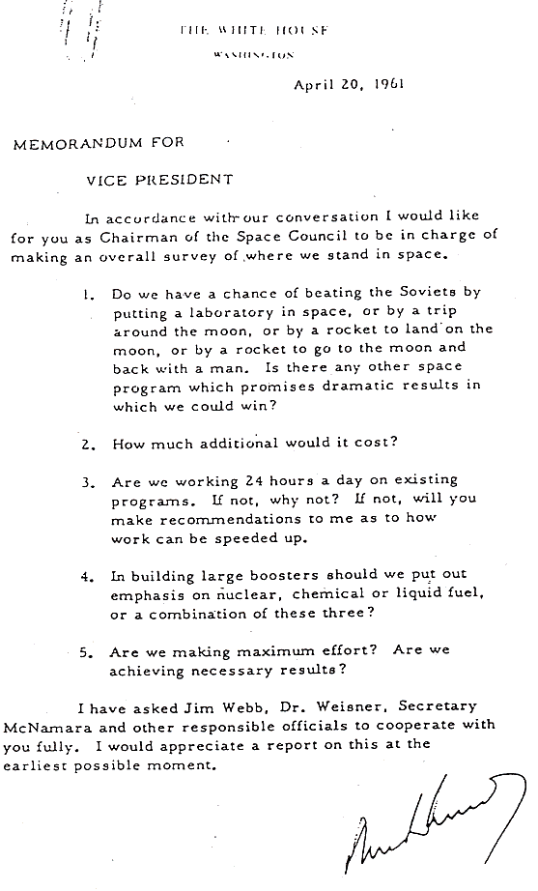
KENNEDY SETS OUT THE REQUIREMENTS
“Do we have a change of beating the Soviets by putting a laboratory in space, or by a trip around the moon, or by a rocket to go to the moon and back with a man. Is there any other space program which promises dramatic results in which we could win?”
John F. Kennedy to
Lyndon B. Johnson
April 20, 1961

Slide 6
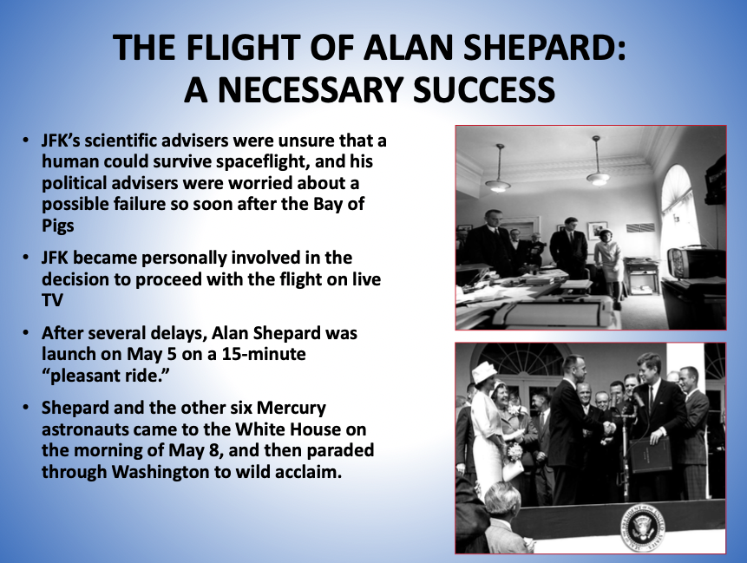

Slide 7
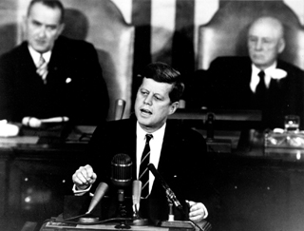
WHY THE MOON?
Lunar landing mission chosen in response to Kennedy’s request because both U.S. and USSR would have to develop a large new rocket to take people to the Moon and back
  Von Braun consulted; tells the White House “a rocket about ten times as powerful as the Soviet Venus launch rocket is required” and
  “we have an excellent chance of beating the Soviets to the first landing of a crew on the moon”
Political rationale provided by NASA head James Webb and Secretary of Defense Robert McNamara in a May 8, 1961 memo
  “It is men, not merely machines, that captures the imagination of the world.”
  Large-scale space projects aimed at “enhancing national prestige” are “part of the battle along the fluid front of the cold war.”
President John F. Kennedy, May 25, 1961:
  “Now it is time to take longer strides – time for a great new American enterprise – time for this nation to take a clearly leading role in space achievement”
  “I believe that this nation should commit itself to achieving to goal, before this decade is out, of landing a man on the moon and returning him safely to earth.”

Slide 8
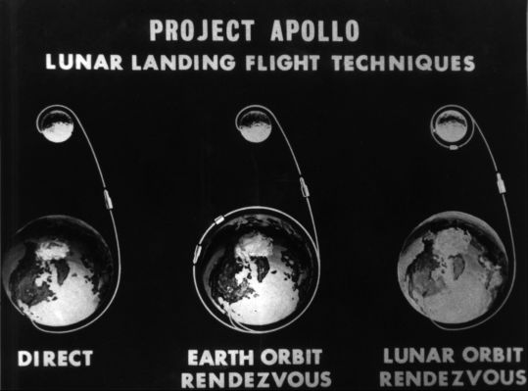
How to Get there?

Slide 9
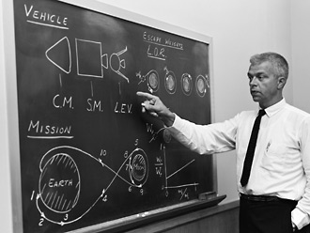
Internal NASA Debate
There was extensive debate within NASA from May 1961- June 1962 on the best approach to a lunar landing mission
  Earth orbital rendezvous
  Lunar orbital rendezvous
John Houbolt, an engineer at Langley Research Center, advocated the LOR approach
Wernher von Braun announced his support of LOR in June 1962
Saturn V launcher selected before this debate was settled
Notes:
John Houbolt, an engineer at Langley Research Center, supported the LOR approach
June 7, 1962. For six hours, Marshall representatives presented their argument for using the EOR approach. At the end of the day-long meeting, after months of steadfastness, von Braun stood up and read from a sheet of paper he had been scribbling on over the course of the day:
We at the Marshall Space Flight Center readily admit that when first exposed to the proposal of the Lunar Orbit Rendezvous Mode we were a bit skeptical—particularly of the aspect of having the astronauts execute a complicated rendezvous maneuver at a distance of 240,000 miles from the earth where any rescue possibility appeared remote. In the meantime, however, we have spent a great deal of time and effort studying the [three] modes, and we have come to the conclusion that this particular disadvantage is far outweighed by [its] advantages.
We understand that the Manned Spacecraft Center was also quite skeptical at first when John Houbolt advanced the proposal of the Lunar Orbit Rendezvous Mode, and that it took them quite a while to substantiate the feasibility of the method and fully endorse it.
Against this background it can, therefore, be concluded that the issue of "invented here" versus "not invented here" does not apply to either the Manned Spacecraft Center or the Marshall Space Flight Center; that both Centers have actually embraced a scheme suggested by a third source....I consider it fortunate indeed for the Manned Lunar Landing Program that both Centers, after much soul searching, have come to the identical solutions.
In the weeks that followed, the final decision to go to the moon using the LOR approach made its way to the desk of Administrator James Webb (a proponent of the direct ascent approach). On June 22, 1962, the Manned Space Flight Management Council announced in favor of the LOR approach.

Slide 10
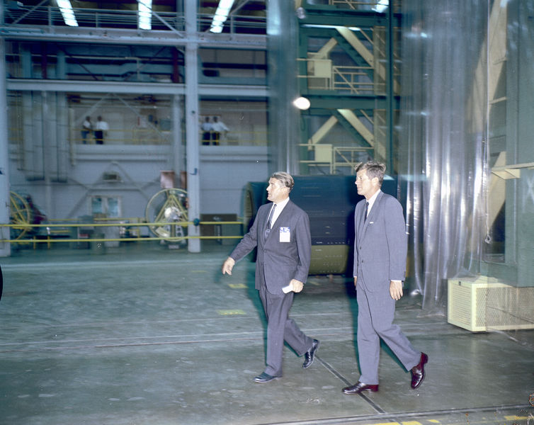
Internal Administration Debate
White House science office objected to the choice of LOR
  Did not trust NASA’s quantitative analyses
  Wanted to develop various capabilities in Earth orbit for national security purposes
Webb and science adviser Wiesner argued as JFK toured Huntsville on September 12, 1962
In midst of Cuban Missile Crisis, JFK decided to defer choice to NASA

Slide 11

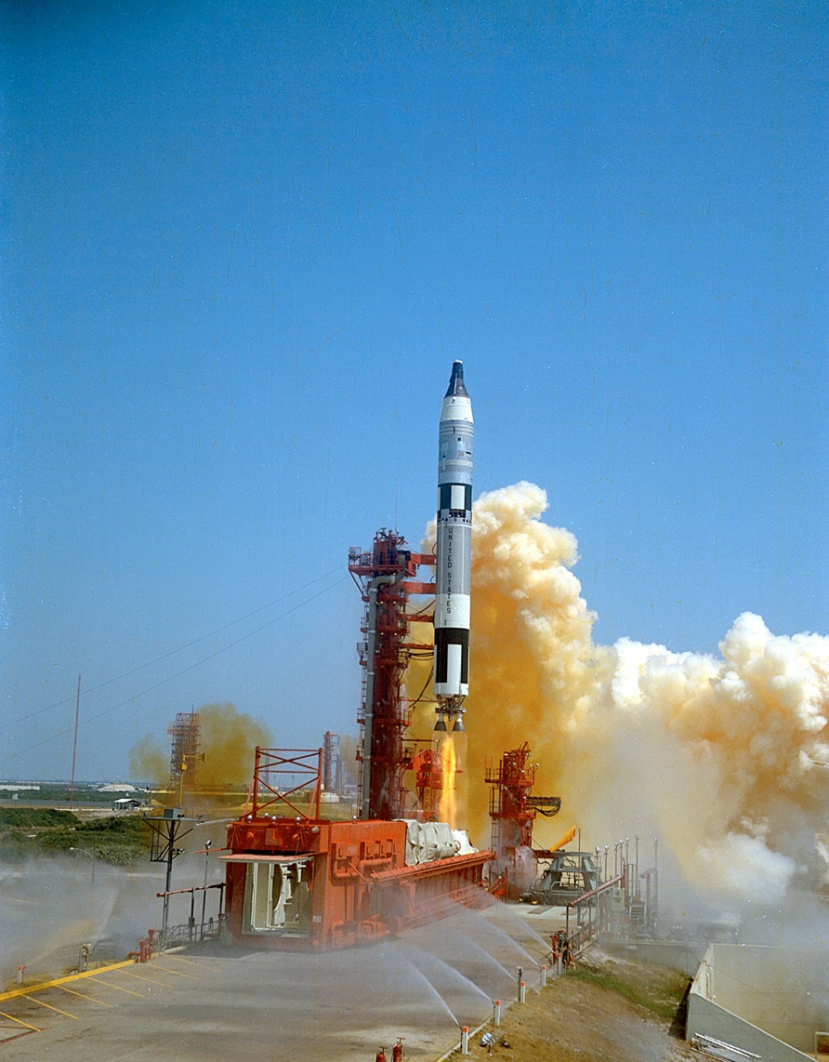
The Gemini Program 1964-1966
Two-man crew
Use of Titan II ICBM
10 manned flights, 2 unmanned
Capable of changing orbit as well as orientation
  Agena upper stage
Military proposals
  Blue Gemini
  Manned Orbital Laboratory
Notes:
To gain experience in these areas before Apollo could be readied for flight, NASA devised Project Gemini. Hatched in the fall of 1961 by engineers at Robert Gilruth's Space Task Group in cooperation with McDonnell Aircraft Corp. technicians, builders of the Mercury spacecraft, Gemini started as a larger Mercury Mark II capsule but soon became a totally different proposition. It could accommodate two astronauts for extended flights of more than two weeks. It pioneered the use of fuel cells instead of batteries to power the ship, and incorporated a series of modifications to hardware. Its designers also toyed with the possibility of using a paraglider being developed at Langley Research Center for "dry" landings instead of a "splashdown" in water and recovery by the Navy. The whole system was to be powered by the newly developed Titan II launch vehicle, another ballistic missile developed for the Air Force. A central reason for this program was to perfect techniques for rendezvous and docking, so NASA appropriated from the military some Agena rocket upper stages and fitted them with docking adapters.
Problems with the Gemini program abounded from the start. The Titan II had longitudinal oscillations, called the "pogo" effect because it resembled the behavior of a child on a pogo stick. Overcoming this problem required engineering imagination and long hours of overtime to stabilize fuel flow and maintain vehicle control. The fuel cells leaked and had to be redesigned, and the Agena reconfiguration also suffered costly delays. NASA engineers never did get the paraglider to work properly and eventually dropped it from the program in favor of a parachute system the one used for Mercury. All of these difficulties shot an estimated $350 million program to over $1 billion. The overruns were successfully justified by the space agency, however, as necessities to meet the Apollo landing commitment.62
By the end of 1963 most of the difficulties with Gemini had been resolved, albeit at great expense, and the program was ready for flight. Following two unoccupied orbital test flights, the first operational mission took place on 23 March 1965. Mercury astronaut Grissom commanded the mission, with John W. Young, a Naval aviator chosen as an astronaut in 1962, accompanying him. The next mission, flown in June 1965 stayed aloft for four days and astronaut Edward H. White II performed the first extra-vehicular activity (EVA) or spacewalk.63 Eight more missions followed through November 1966. Despite problems great and small encountered on virtually all of them, the program achieved its goals. Additionally, as a technological learning program Gemini had been a success, with 52 different experiments performed on the ten missions.

Slide 12
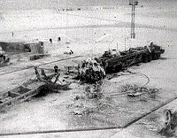
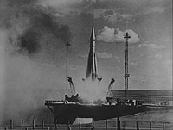
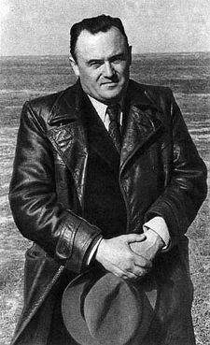
Loss of Key Soviet Space Leaders
Nedelin Disaster
  Pad explosion of ICBM R-16
  October 24, 1960
  Est. 130 dead including a Strategic Rocket Forces Marshall
  Kept secret at the time
Sergey Korolyov
  Leader of Soviet ICBM, Sputnik, and Vostok programs
  Survivor of the Gulag
  Died during surgery January 14, 1966
See “Challenge to Apollo” by Asif A. Siddiqi
R-7 Launch

Slide 13
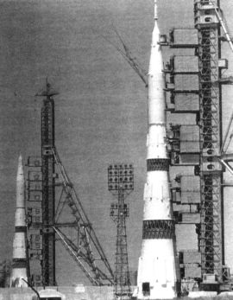
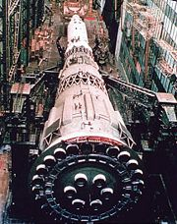
Soviet N-1 Lunar Booster
Soviet approach to the Moon was Earth orbit rendezvous.
  Multiple launches to build up a complete package
  One for the Soyuz, another for the lunar lander and additional launches with fuel
Multiple test flight failures
  February 21, 1969
  July 3, 1969
  June 27, 1971
  November 23, 1972
Notes:
Development of the N1 began in 1959 under the direction of Sergei Korolev at his OKB-1 Design Bureau. The original design proposed a 50-metric-ton (110,000 lb) payload intended as a launcher for military space stations and a manned Mars flyby using a nuclear engine upper stage. The N1 was the largest of three proposed designs; the N2 was somewhat smaller and intended to compete with Vladimir Chelomei's proposed UR-200, and the much smaller N3, which would replace Korolev's "workhorse" R-7 rocket. At this point the N-series was strictly a "paper project".
In December 1959 a meeting was called with all of the chief designers, who presented their latest designs to the military. Korolev presented the N-series along with a much more modest series of upgrades to the R-7. Vladimir Chelomei, Korolev's rival, presented his "Universal Rocket" series, which used a common lower stage in various clustered configurations to meet a wide variety of payload requirements. Mikhail Yangel, perhaps the most successful of the three but with little political power, presented the small R-26 intended to replace the R-16, the much larger R-36 ICBM, as well as the SK-100, a space launcher based on a huge cluster of R-16's. In the end the military planners selected Chelomei's UR-100 as the new "light" ICBM, and Yangel's R-36 for the "heavy" role. They saw no need for any of the larger dedicated launchers, but also gave Korolev funding to develop the Molniya (8K78) adaptation of the R-7. In March 1961, during a meeting at Baikonur, designers discussed the N1 design, along with a competing Glushko design, the R-20. In June, Korolev was given a small amount of funding for N1 development between 1961 and 1963. In May 1961 a government report, On Reconsideration of the Plans for Space Vehicles in the Direction of Defense Purposes, set the first test launch of the N1 rocket for 1965.
The N1 was a very large rocket, standing 105 metres (344 ft) tall—among the world's largest launch vehicles, somewhat smaller than the Saturn V in height and mass, but greater in lift-off thrust, but with significantly less payload capability. The N1-L3 consisted of five stages in total, three for immediate boost into orbit (the N1), and another two for the lunar portion (the L3). Fully loaded and fueled, the N1-L3 weighed 2,788 metric tons (6,150,000 lb). The lower three stages were shaped to produce a single truncated cone just over 10 m wide at the base, while the L3 section was cylindrical at about 4.4 m wide. The conical shaping of the lower stages was due to the arrangement of the tanks within, a smaller spherical kerosene tank on top of the larger liquid oxygen tank below.
The first stage, Block A, was powered by 30 NK-15 engines arranged in two rings, the main ring of 24 at the outer edge of the booster, the inner of 6 at about half diameter. The engines were the first ever staged combustion cycle engines. The control system was primarily based on differential throttling of the engines, the outer ring for pitch and yaw, the inner six on gimballing mounts for roll. The Block A also included four grid fins, which were later used on Soviet air-to-air missile designs. In total, the Block A produced 43 meganewtons (9,700,000 lbf)^{[1]} of thrust. This exceeded the 33.7 meganewtons (7,600,000 lbf)^{[2]} thrust of the Saturn V.
The second stage, Block B, was powered by 8 NK-15V engines arranged in a single ring. The only major difference between the NK-15 and -15V was the engine bell and various tunings for air-start and high-altitude performance. The upper stage, Block V (V being the third letter in the Russian alphabet), mounted four smaller NK-21 engines in a square.
During the N1's lifetime, a series of improved engines was introduced to replace those used in the original design. The first stage used an adaptation of the NK-15 known as the NK-33, the second stage a similar modification known as the NK-43, and finally the third stage used the NK-31. The resulting modified N1 was known as the N1F, but did not fly before the project's cancellation.

Slide 14
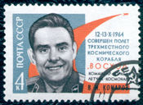

Soviet Human Spaceflight Losses
Soyuz 1
  April 24, 1967
  Multiple problems on orbit
  Parachute failure
  Intercepted communications
  Colonel Vladimir Komarov killed on impact
  First in-flight fatality
Salyut 11
  June 30, 1971,
  23 days on-orbit, nominal landing
  3 crew lost due to depressurization on re-entry
  No 3-man crew until 1980 with Soyuz-T

Slide 15
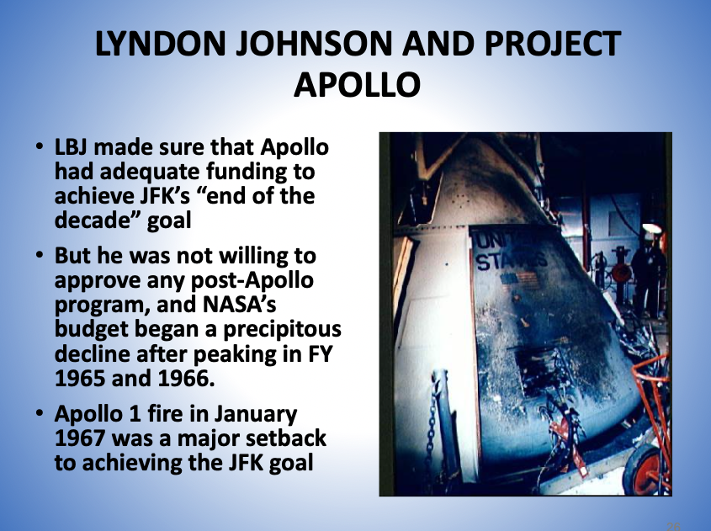
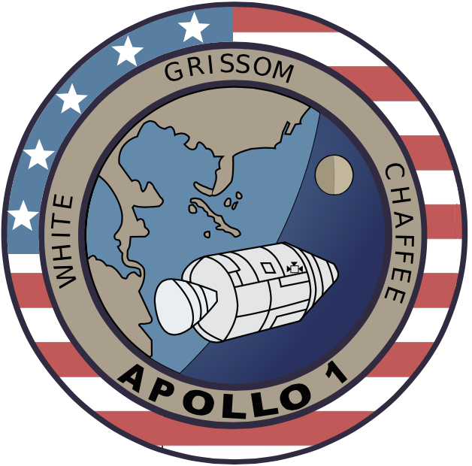
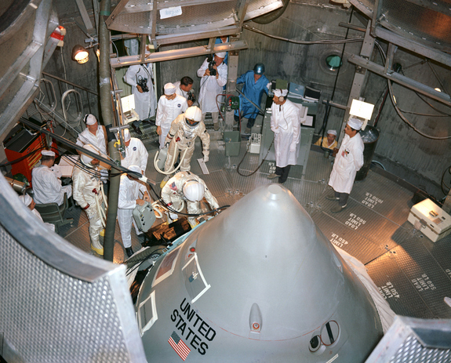

Slide 16
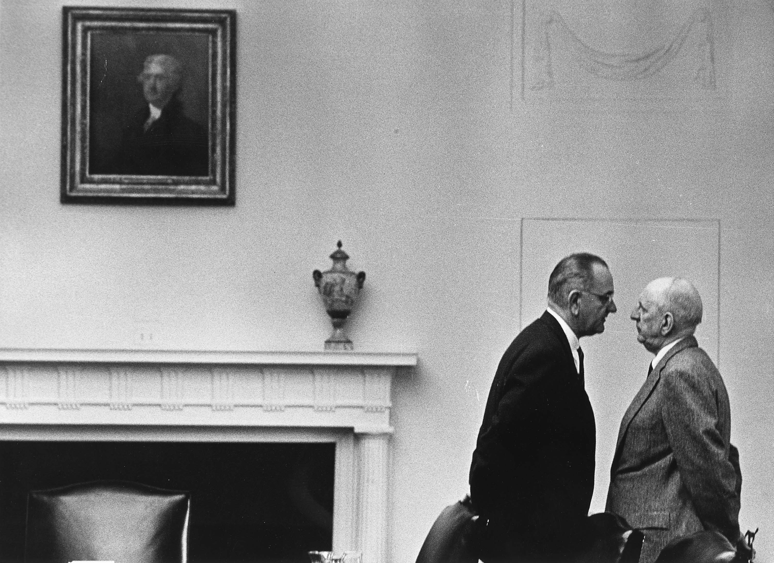
Lyndon Baines Johnson 1957-69
As Senator
National Security
  1957 Missile gap hearings
  1958 Civilian NASA
“I do not believe that this generation of Americans is willing to resign itself to going to bed each night by the light of a Communist moon”.
Personal and party politics
  1960 Election
Domestic social advancement
  Later the Great Society
As Vice President
National Aeronautics and
Space Council
  MSC in Houston 1961
As President
No new space
commitments in FY65
Budgetary constraints
1967 Outer Space Treaty
defuses the space race
1967 Apollo 1 Fire
Webb resignation
September 1968
Notes:
Rep. Albert Thomas on House Appropriations was responsible for the Houston location.

Slide 17
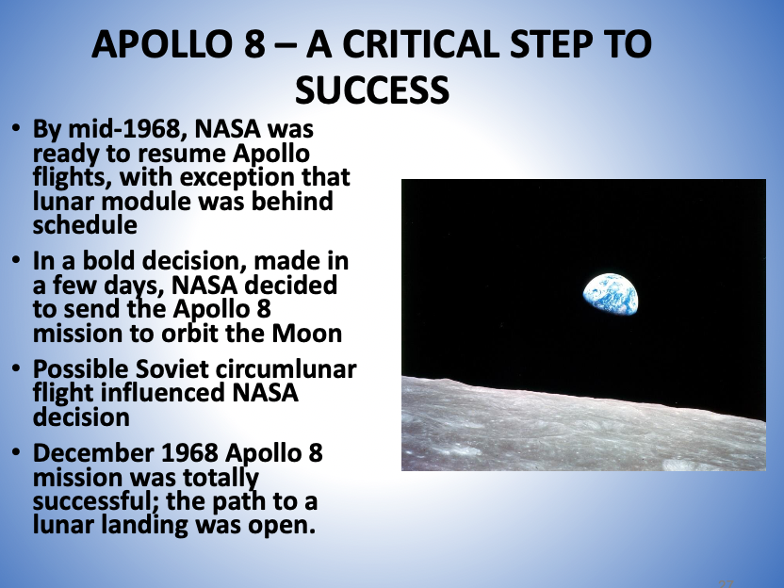
THE HERITAGE OF APOLLO
“To see the Earth as it truly is, small and blue and beautiful in that eternal silence where it floats, is to see ourselves as riders on the Earth together, brothers on that bright loveliness in the eternal cold–brothers who know now that they are truly brothers.”
  – Archibald McLeish, December 25, 1968

Slide 18
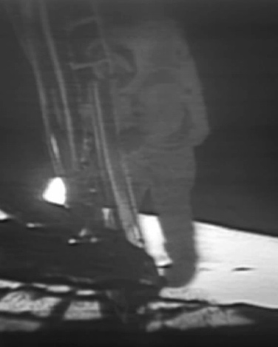
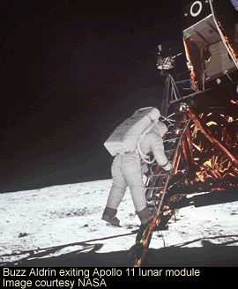
First and Second Men on the Moon

Slide 19
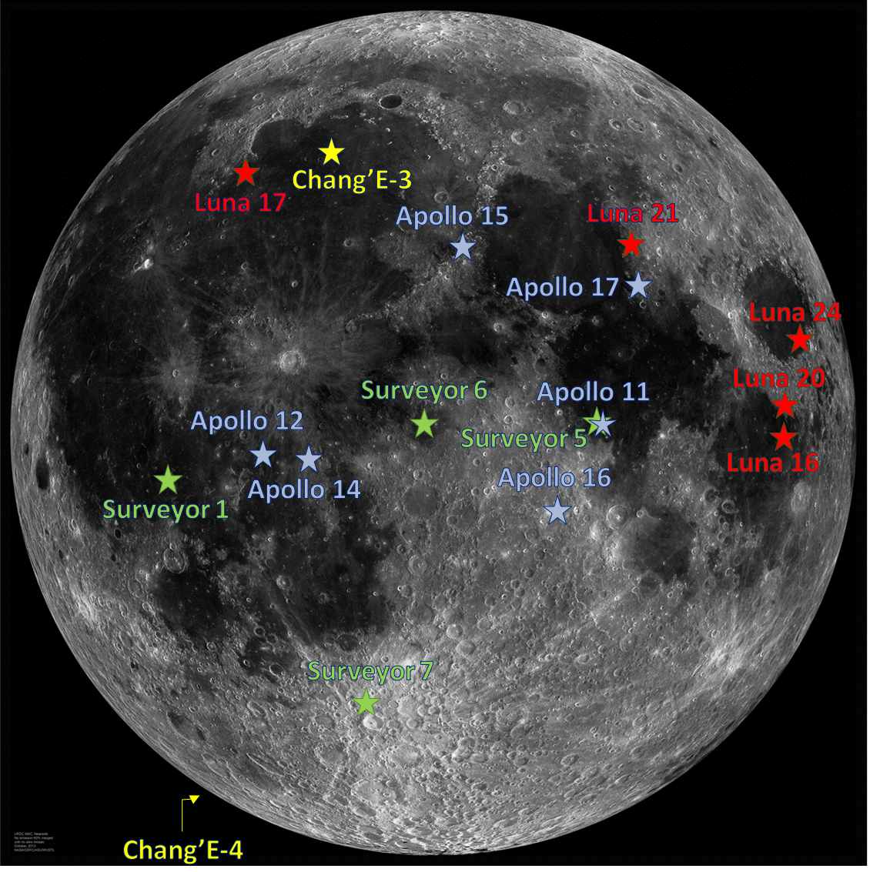
Lunar Landing Sites

Slide 20
Apollo Highlights
Apollo 1 fire - 1967
Apollo 8 goes around the Moon - 1968
Apollo 11 landing on the Moon - 1969
Apollo 13 accident - 1970
Apollo 17 leaves the lunar surface - 1972
Apollo-Soyuz Test Project - 1975
Built on the lessons learned from Gemini
  rendezvous and docking
  space walking
  long duration missions
  emergency procedures

Slide 21
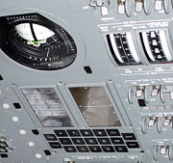

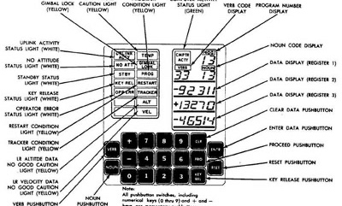
Apollo Guidance Computer
Two AGCs per mission
  command module
  lunar module
First use of integrated circuits
  RAM 4k words
  ROM 32k words
Commands as two-digit numbers
  "program", "verb", and "noun”
1202/1201 alarm on Apollo 11
  LEM Software by Margaret Hamilton
  Jack Garman->Steve Bales->Gene Kranz
  See “Digital Apollo” by David Mindell
Notes:
PGNCS generated unanticipated warnings during Apollo 11's lunar descent, with the AGC showing a 1201 alarm ("Executive overflow - no vacant areas") and a 1202 alarm ("Executive overflow - no core sets").^{[9]} The cause was a rapid, steady stream of spurious cycle steals from the rendezvous radar, intentionally left on standby during the descent in case it was needed for an abort.^{[10][11]}
During this part of the approach, the processor would normally be almost 85% loaded. The extra 6,400 cycle steals per second added the equivalent of 13% load, leaving just enough time for all scheduled tasks to run to completion. Five minutes into the descent, Buzz Aldrin gave the computer the command 1668 which instructed it to calculate and display DELTAH (the difference between altitude sensed by the radar and the computed altitude). This added an additional 10% to the processor workload, causing executive overflow and a 1202 alarm. After being given the "GO" from Houston, Aldrin entered 1668 again and another 1202 alarm occurred. When reporting the second alarm, Aldrin added the comment "It appears to come up when we have a 1668 up". Luckily for Apollo 11, the AGC software had been designed with priority scheduling. Just as it had been designed to do, the software automatically recovered, deleting lower priority tasks including the 1668 display task, to complete its critical guidance and control tasks. Guidance controller Steve Bales and his support team that included Jack Garman issued several "GO" calls and the landing was successful. For his role, Bales received the US Presidential Medal of Freedom on behalf of the entire control center team and the three Apollo astronauts.^{[12]}
The problem was not a programming error in the AGC, nor was it pilot error. It was a peripheral hardware design bug that was already known and documented by Apollo 5 engineers.^{[13]}However, because the problem had only occurred once during testing, they concluded that it was safer to fly with the existing hardware that they had already tested, than to fly with a newer but largely untested radar system. In the actual hardware, the position of the rendezvous radar was encoded with synchros excited by a different source of 800 Hz AC than the one used by the computer as a timing reference. The two 800 Hz sources were frequency locked but not phase locked, and the small random phase variations made it appear as though the antenna was rapidly "dithering" in position, even though it was completely stationary. These phantom movements generated the rapid series of cycle steals.

Slide 22
Break Point
See Discovery Video on YouTube – “When We Left Earth”
Gemini chapter, Apollo chapter
Apollo 11 – The Complete Descent
https://www.youtube.com/watch?v=xc1SzgGhMKc

Slide 23
THE APOLLO BUILDUP
NASA Budget
  FY1961 - $0.964 billion
  FY1962 - $1.825 billion – 89% increase
  FY 1963 - $3.674 billion – 101% increase
Construction of facilities
  FY 1961 - $98.2 million
  FY 1962 - $217.1 million – 121% increase
  FY 1963 - $569.8 million – 162% increase
Personnel
  1961 – 17, 500 in-house, 57,000 contractors – 1:3.3 ratio
  1962 – 23,700 in-house, 115,500 contractors – 1:4.9 ratio
  1963 – 29,900 in-house, 218,400 contractors - 1:7.3 ratio
  1964 – 32,500 in-house, 347,100 contractors – 1:10.7 ratio
Costs of other NASA programs in 2015 dollars
Space Shuttle — $229 Billion
Space Station (Freedom + ISS) — $60 Billion (construction only)
Apollo costs in 2015 dollars — $165 Billion
  Panama Canal — $9 Billion
  Manhattan Project — $31 Billion
  Interstate Highway System — $140 Billion

Slide 24
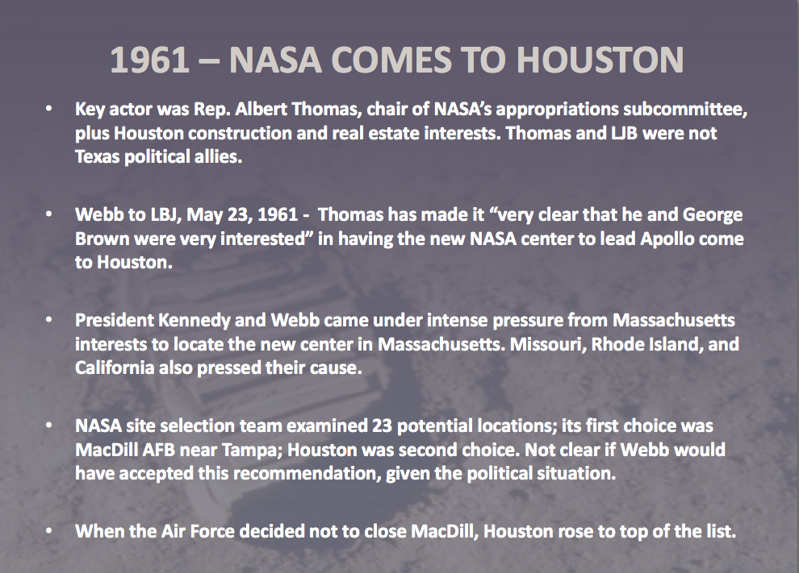
Source: John Logsdon, “JFK and the Race to the Moon” (2010)

Slide 25
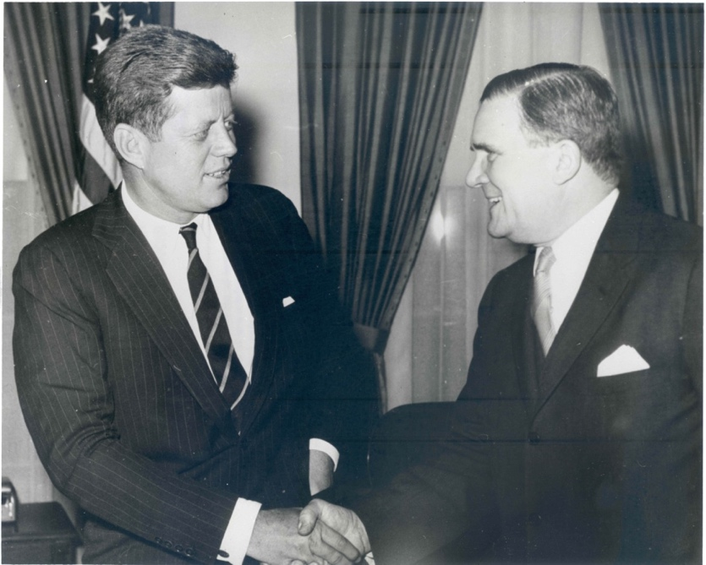
DIFFERING VIEWS ON U.S. SPACE GOALS
President Kennedy, November 21, 1962 – “This is important for political reasons, international political reasons. . . Everything that we do ought really to be tied to getting to the moon before the Russians. . . . I’m not that interested in space.”
James Webb, November 30, 1962 – “The objective of our national space program is to become preeminent in all important aspects of this endeavor. . . The manned lunar landing program, although of highest national priority, will not by itself create the preeminent position we seek.”
https://www.youtube.com/watch?v=ocywOcHYEkk Oval Office Recording
Notes:
YouTube JFK Tape
http://www.youtube.com/watch?v=ocywOcHYEkk&feature=related
More tapes
http://www.collectspace.com/ubb/Forum29/HTML/001253.html

Slide 26
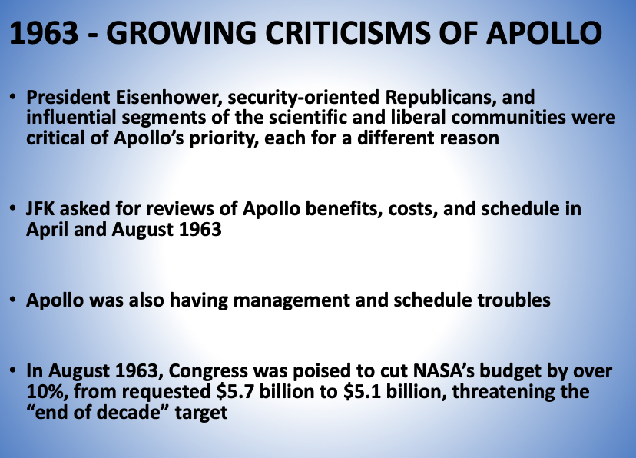

Slide 27
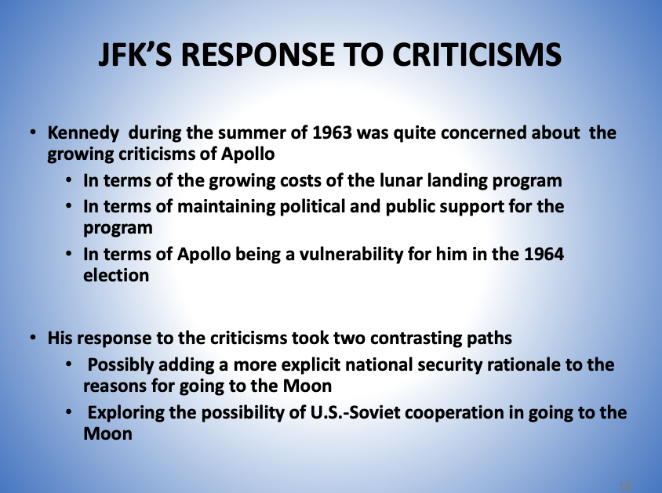

Slide 28
PROJECT APOLLO AND NATIONAL SECURITY
On September 18, 1963, JFK met with James Webb to discuss the political problems associated with Apollo
  JFK – “Right now, I don’t think the space program has a lot of political positives. . . . I think this can be an asset, this program. . . . This is mid-journey and therefore everybody says ‘what the hell are we making this trip for’ but at the end of the thing they may be glad we made it. But I think we’ve got to defend ourselves now . . . Unless the Russians do something spectacular, the only way we can defend ourselves is if we put a national security rather than a prestige label on this.”
In early October 1963, as he awaited a Soviet response to his cooperative proposal, Kennedy ordered a sweeping review of the total U.S. space program, both civilian and military.
- John Logsdon

Slide 29
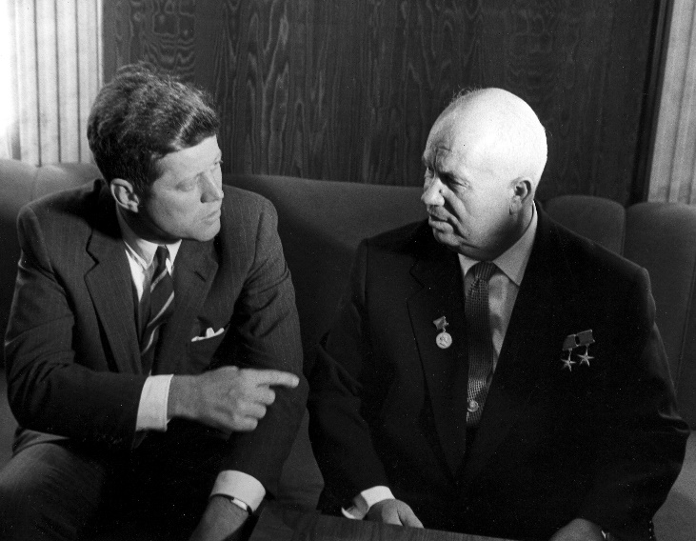
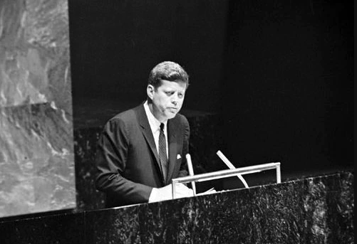
GOING TO THE MOON WITH THE SOVIET UNION: PURSUIT OF AN ILLUSION?
In his Inaugural Address, JFK suggested to the Soviet Union “together let us explore the stars.” He never lost the hope for U.S.-Soviet space cooperation, even as he decided to compete
Ten days after announcing his decision to go to the Moon, JFK met Nikita Khrushchev in Vienna and proposed going to the Moon together. Khrushchev said “no”
On September 20, 1963, Kennedy spoke to the General Assembly of the United Nations and proposed US – USSR cooperation in lunar exploration; he followed this up with a November 12, 1963 national security memorandum asking for a study of how such cooperation might work

Slide 30
WERE MAJOR CHANGES IN THE WIND?
During this review, slowing down or even canceling Apollo was considered; some senior JFK advisors favored at least relaxing the “end of the decade” deadline.
Robert McNamara and his DOD associates were consistent in their view that Apollo had no direct military value.
The Bureau of the Budget, which was managing the review, concluded that “in the absence of clear changes in the technical or international situations, the only basis for backing off” from the end of the decade goal was fiscal, but that the costs of the program could be accommodated in projected budgets.
JFK was assassinated before results of review reached his desk, although he may have been briefed on the preliminary conclusions.
- John Logsdon

Slide 31
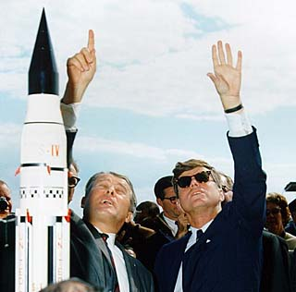
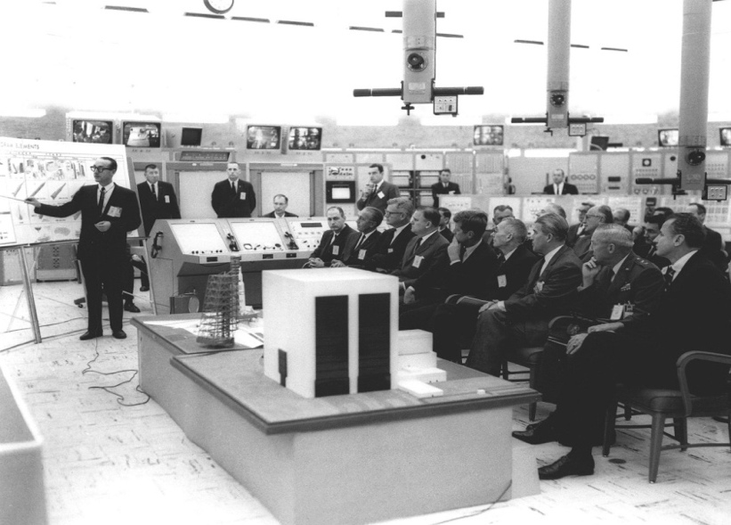
JFK REGAINS HIS ENTHUSIASM
JFK visited Cape Canaveral on November 16, 1963
There, he was briefed on Apollo plans
  NASA #3 Robert Seamans – “maybe for the first time, [JFK] began to realize the dimensions of these projects”
Kennedy also was briefed by Wernher von Braun in front of a Saturn 1 booster being readied for a December launch; that launch would give the U.S. a lead in lifting power
Kennedy came away from his visit very enthused about what he had seen.
Six days later he fell victim to an assassin’s bullet

Slide 32
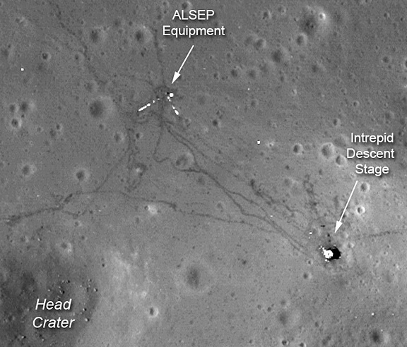
DID THE U. S. REALLY GO TO THE MOON?
Apollo 12 as seen by LRO
Notes:
See Mythbusters episodes

Slide 33
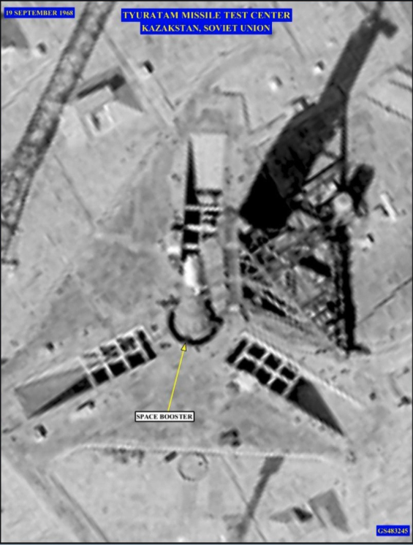
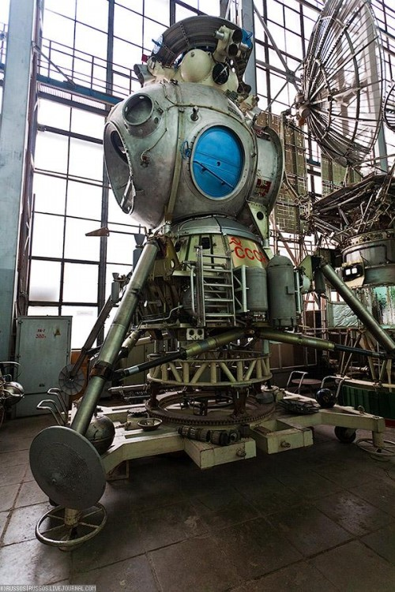
WAS THE SPACE RACE REAL?
At the time Kennedy made the decision to go to the Moon, the United States did not know whether the USSR had a lunar landing program
In fact, such a program was not approved until 1964
Soviet “chief designer” Sergei Korolev died in 1966
There was a rival circumlunar robotic program that came close to success
The USSR built a lunar lander and trained cosmonauts for a Moon mission, but the N-1 rocket was a failure
Soviet lunar program canceled in 1974
Lander photographed by U.S. scientists in Moscow, 1989
N-1 failed in found launch attempts
LK test flown in Earth orbit four times
Corona Image 1968
Notes:
A photograph of the Soviet Lunar Lander and Return Vehicle taken at the Moscow Aviation Institute on 28 November 1989. The occasion was a visit by three Massachusetts Institute of Technology (MIT) professors—Lawrence Young (left center), Jack Kerrebrock (the photographer), and Edward Crawley (not pictured).
On July 21, 1969, while Apollo 11 astronauts finished the first human moonwalk, Luna 15 - an unmanned Soviet spacecraft in lunar orbit at the time, began its descent to the lunar surface. Launched only three days before the Apollo 11 mission, it was the third Soviet attempt to return lunar soil back to Earth. The Russian craft crashed on the moon at 15:50 UT – just a few hours before the scheduled American lift off.^{[1]}

Slide 34
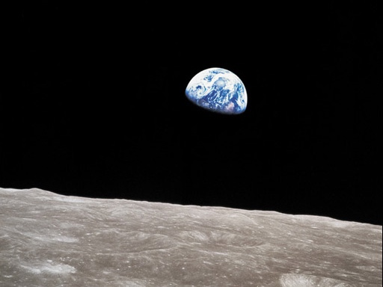
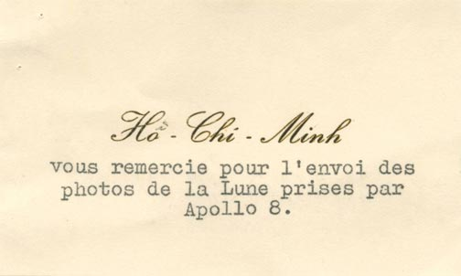
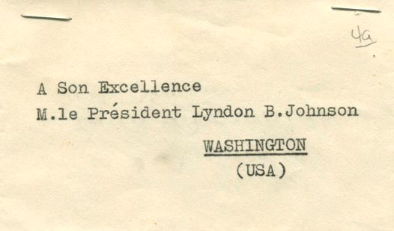

Slide 35
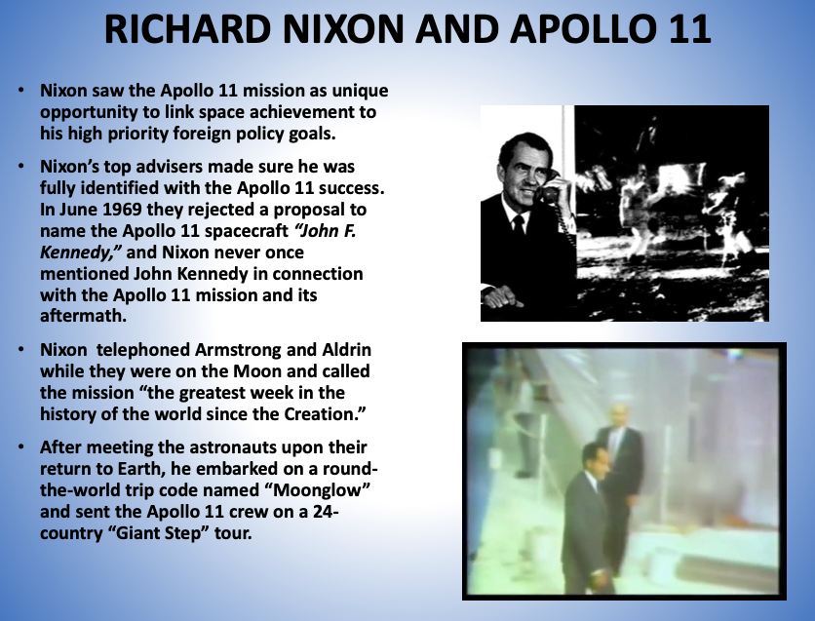

Slide 36
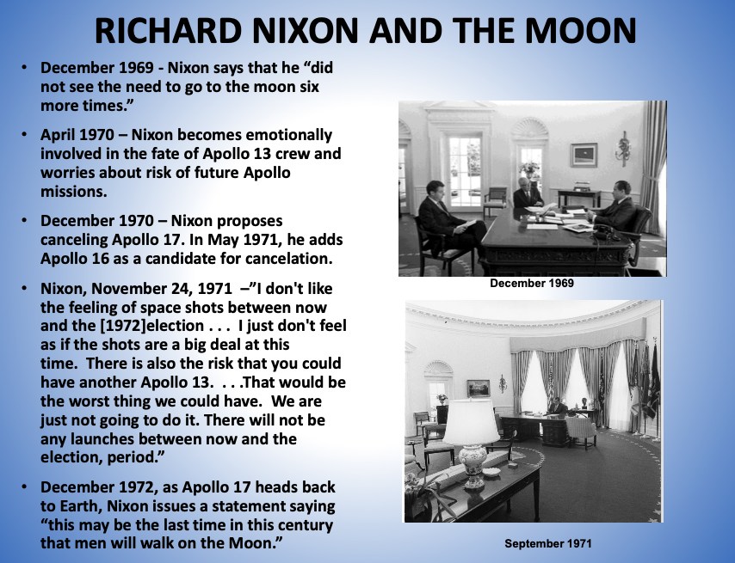

Slide 37
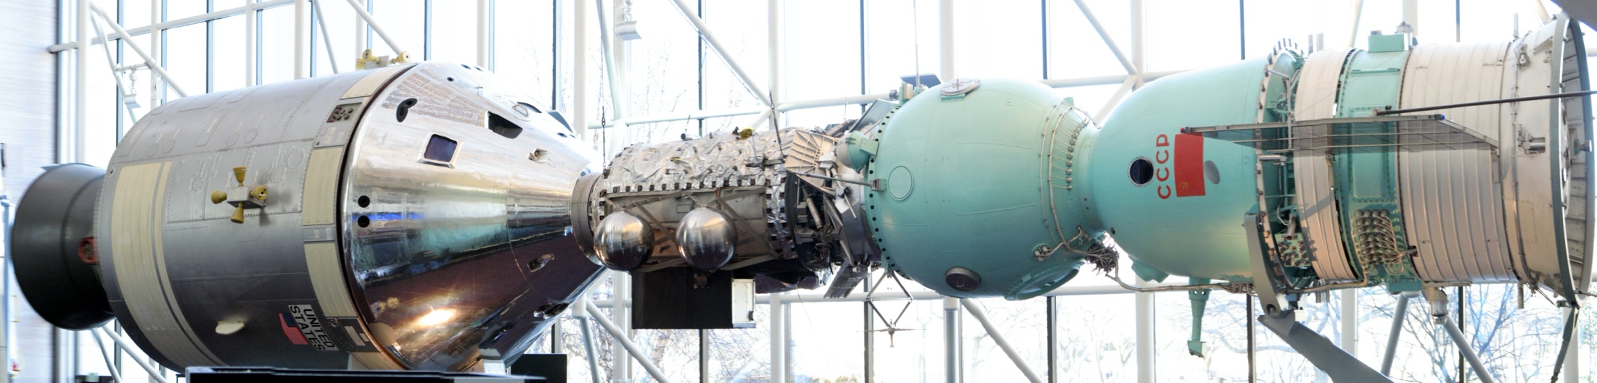
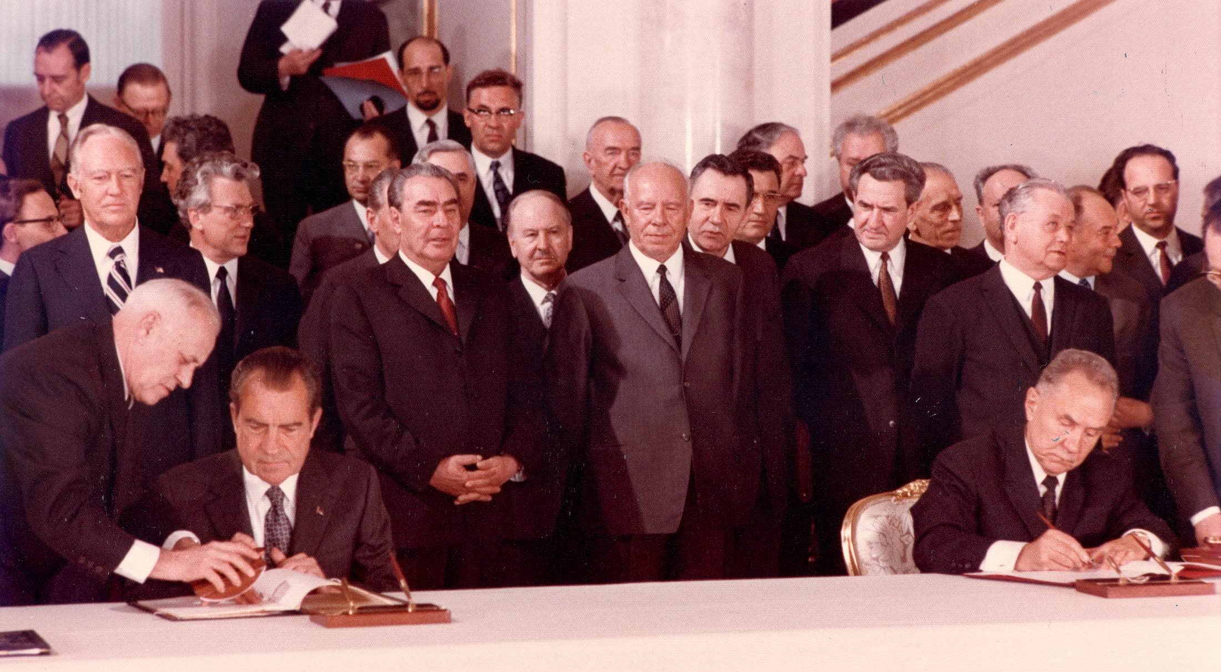
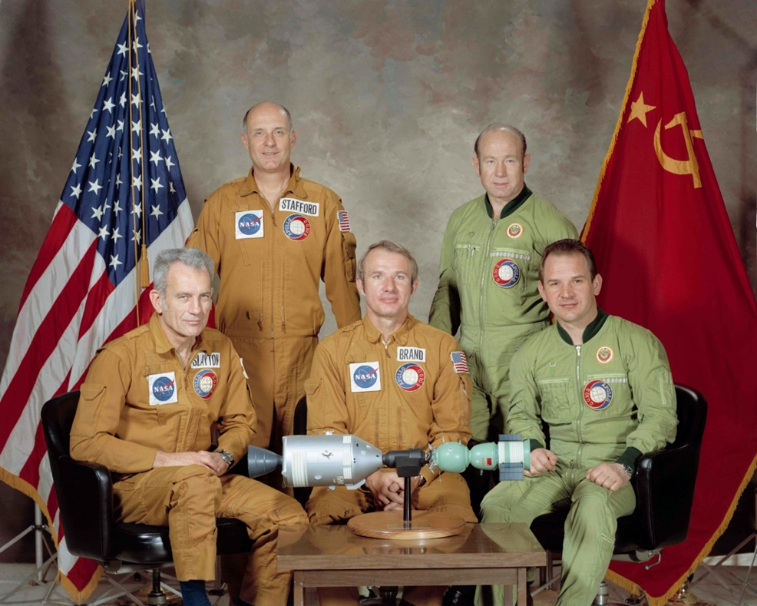
Apollo-Soyuz in the Air and Space Museum
Notes:
Tom Stafford chaired ISS advisory committee
Vane Brand commanded post-Challenger Shuttle missions, retired in 2008.
Thomas P. Stafford: Commander of the American crew
Donald K. "Deke" Slayton: Docking module pilot of the American crew
Vance D. Brand: Command module pilot of the American crew
Aleksey A. Leonov: Commander of the Soviet crew
Valeriy N. Kubasov: Flight engineer of the Soviet crew
The ASTP was scheduled for launch in July 1975, and the mission included docking and re-docking maneuvers, as well as the Apollo crew creating an artificial solar eclipse for the Soyuz crew to photograph. After 44 hours together, the two ships separated and the Apollo crew conducted Earth observation experiments while the Soviets remained in space for five days. The Apollo Command Module splashed down in the Central Pacific Ocean on July 24, 1975, and the crew remained in the spacecraft until it was hoisted aboard the USS New Orleans

Slide 38
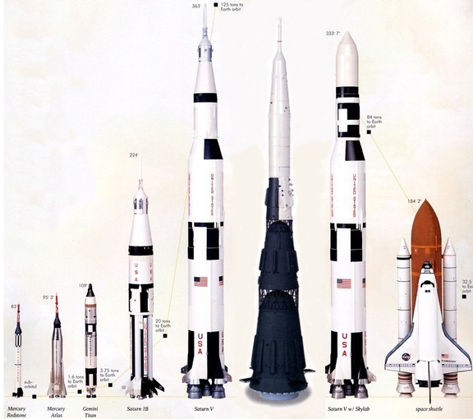
A Sense of Scale

Slide 39
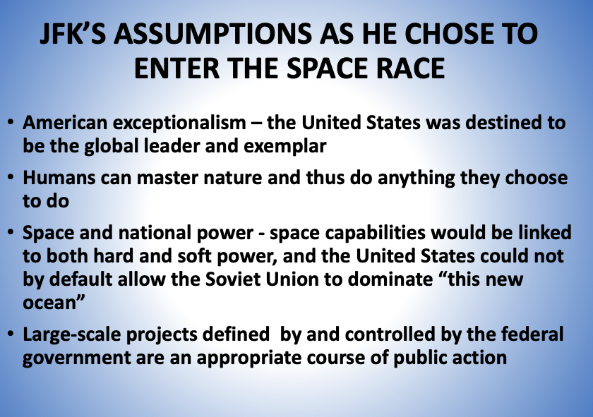

Slide 40
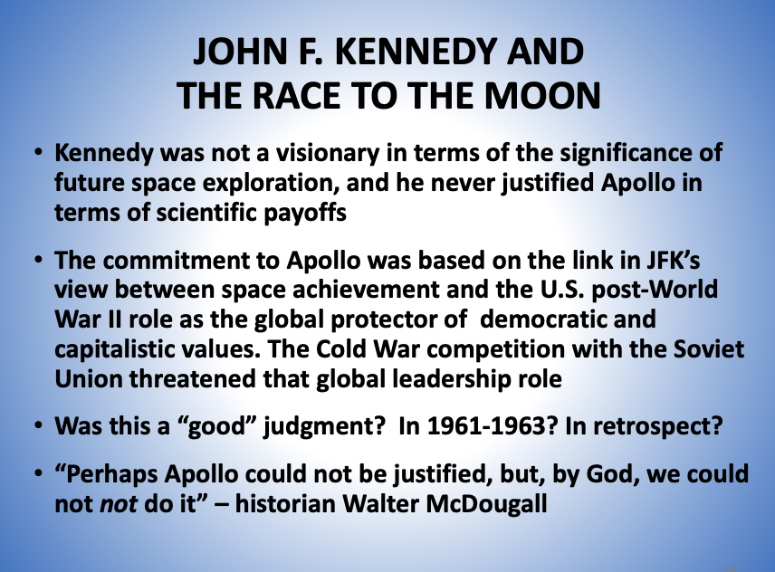

Slide 41
Backups

Slide 42
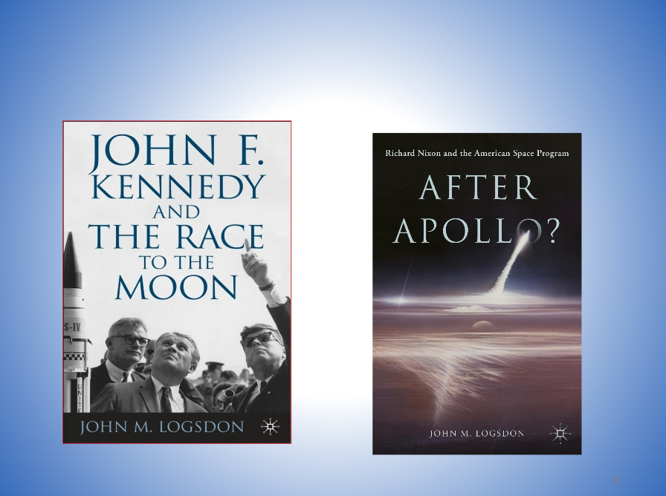

Slide 43
IMPACTS OF APOLLO?
In terms of goals set by JFK?
In terms of impact on post-Apollo space development?
In terms of economic and technological impact?
In terms of human history
“The politics of the moment had become linked to the dreams of centuries”

Slide 44
Topics for Discussion
Civil versus military leadership of human spaceflight
  NASA or the Air Force?
Why did McNamara agree with Webb?
  Managing the Air Force
  Industrial base needs
Was going to the Moon a new idea in 1961?
  NASA and Air Force perspectives
  How much was technically known at the time?
  Was economic stimulus a factor?
What role did the events of 1961 play in influencing President Kennedy’s speech to the Congress?
  What if JFK had lived?
Scientific community assessment of human spaceflight
  Wiesner report versus Space Science Board
Congressional dynamics and geography
  the Second Reconstruction
  Passage of reform legislation
Presidential priorities
  Ike - New Look, intelligence on Soviet capabilities
  JFK - New Frontier, international prestige
  LBJ - Great Society, domestic reform

Slide 45
Topics for Discussion (cont.)
Technical choices for the Moon
  Beating the Soviets over time
  Direct versus Lunar orbit rendezvous versus Earth orbit rendezvous
  Implications for returning to the Moon?
    Technically
    Politically
    Role of industry and the private sector
    Future Mars missions?

Slide 46
4.4% of Federal Budget
0.6% of Federal Budget
Major RIF
Hiring Freeze
Flexibility Act passed
Challenger
Accident
First Apollo Landing
Announced
Exploration
Vision

Slide 47
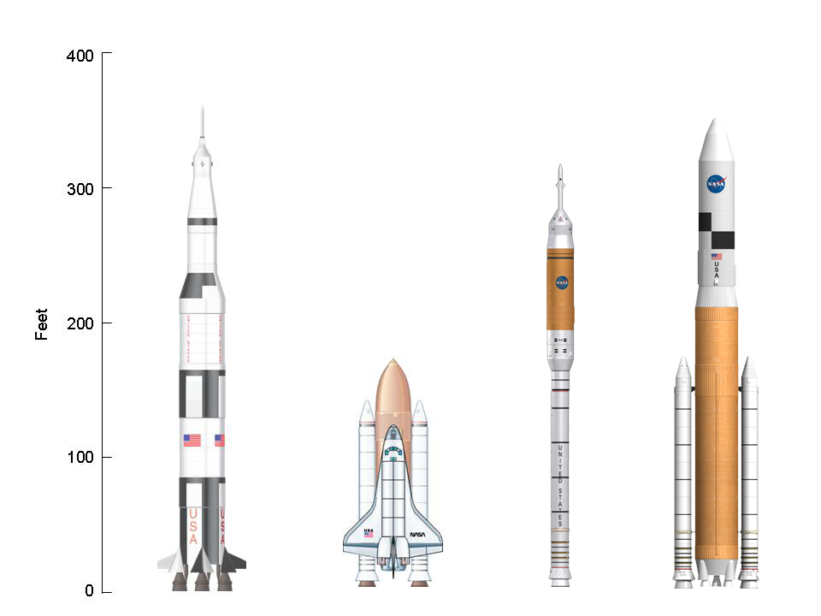
Comparison to Ares I and Ares V

